Slide 1
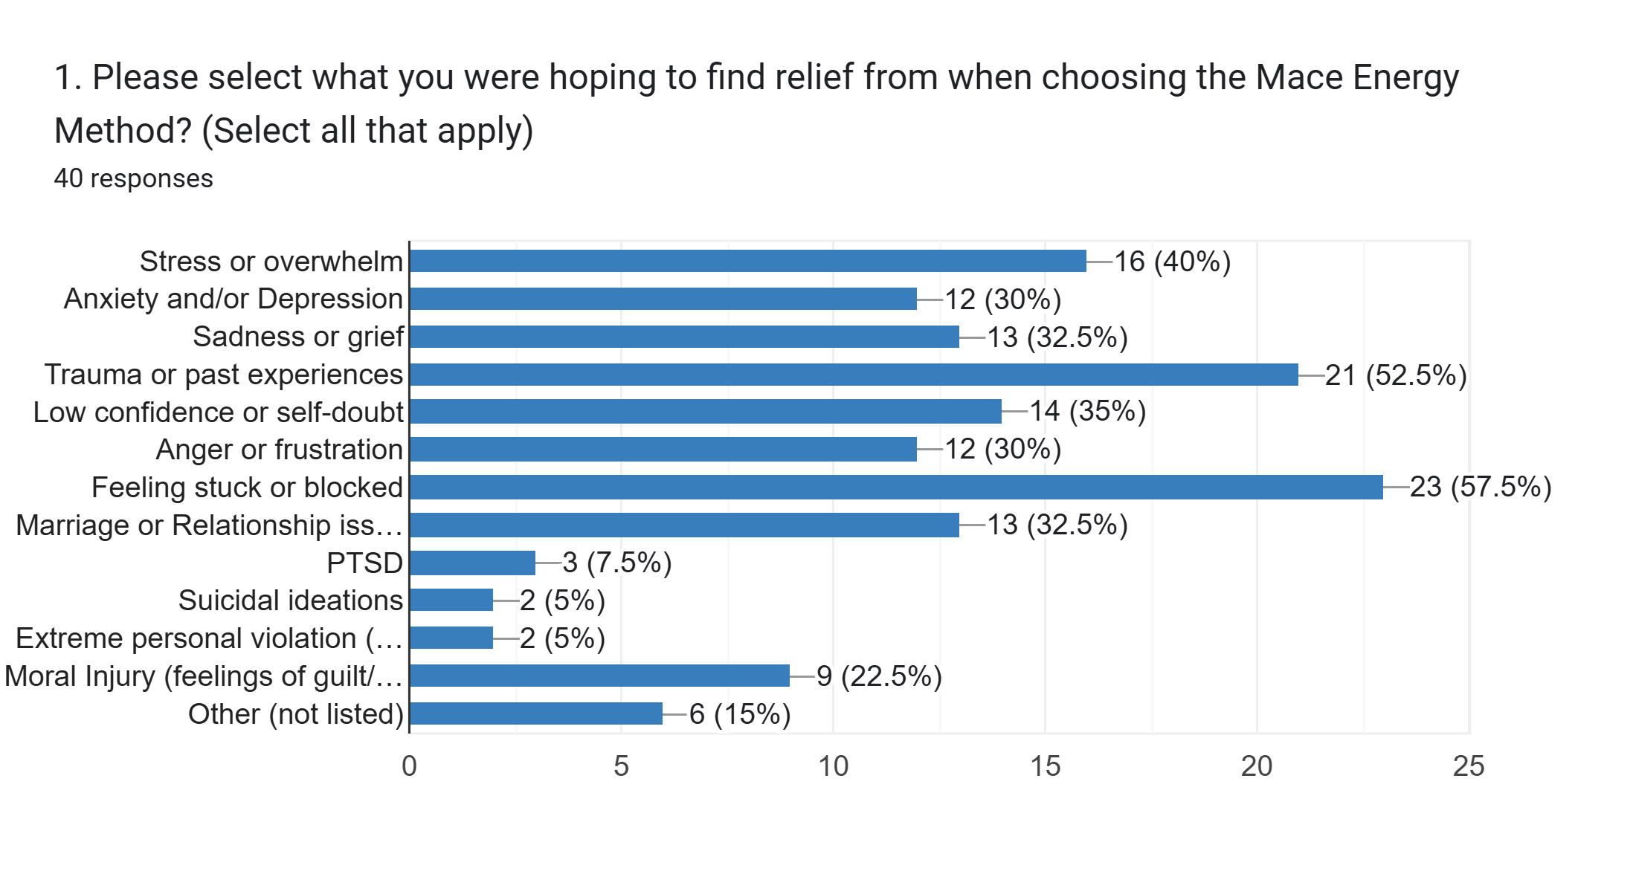
Mace Energy Impact Survey 2024-Present

Slide 2
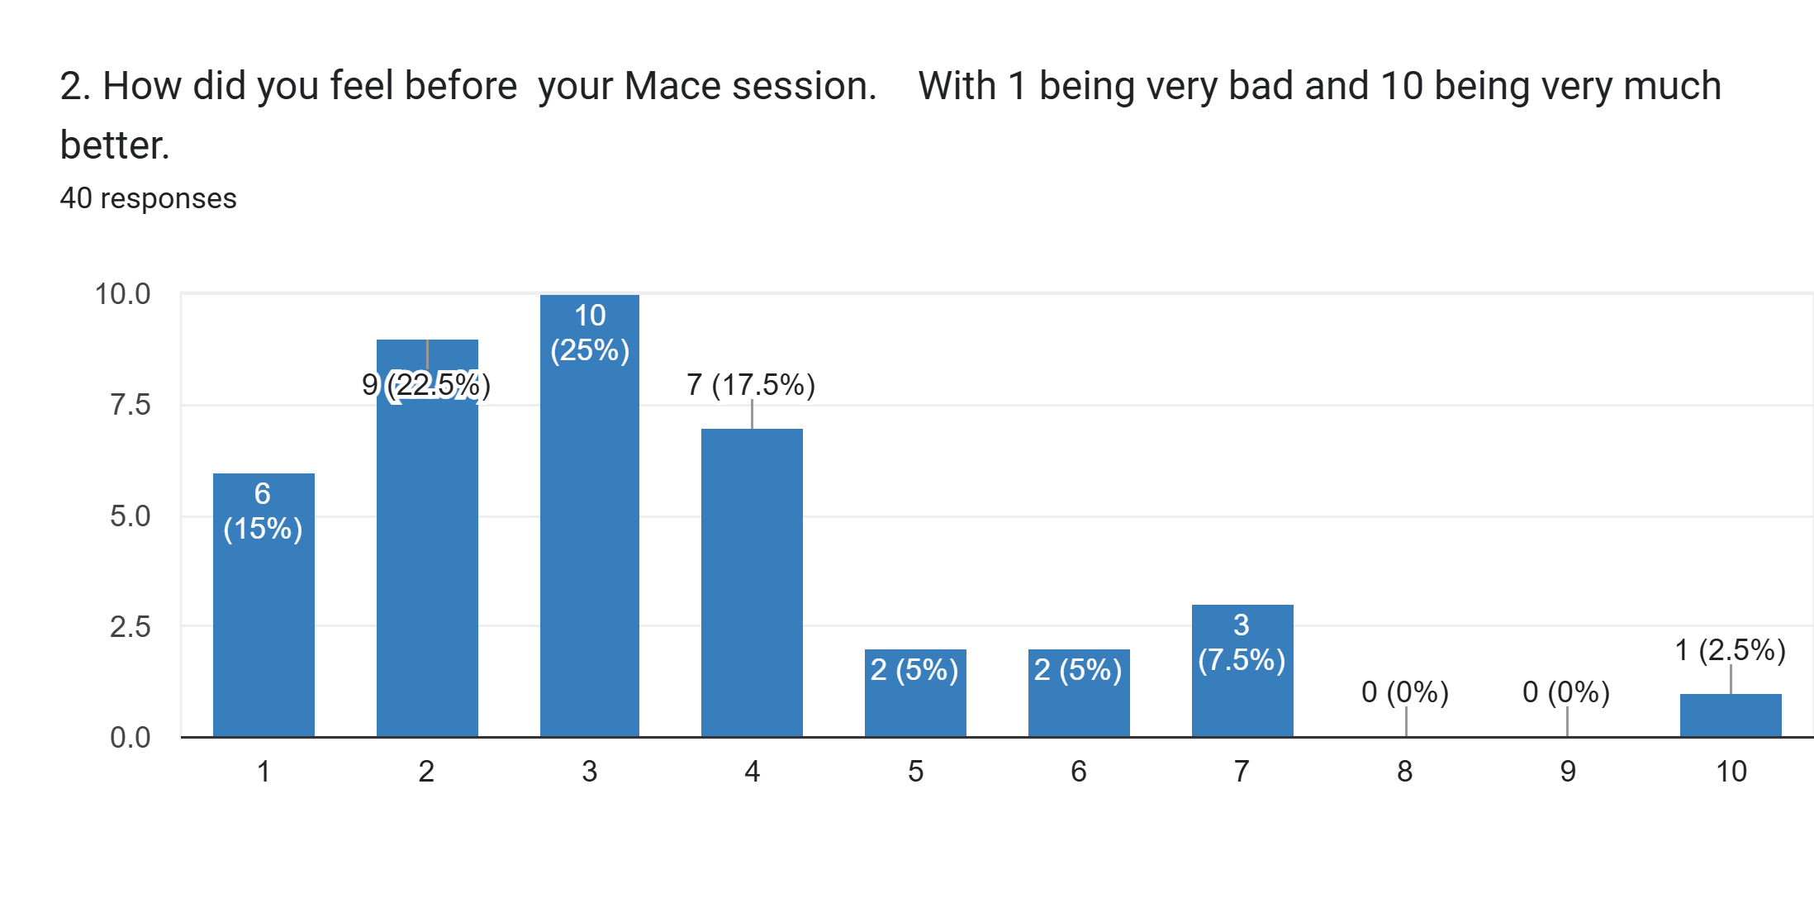
Mace Energy Impact Survey 2024-Present

Slide 3
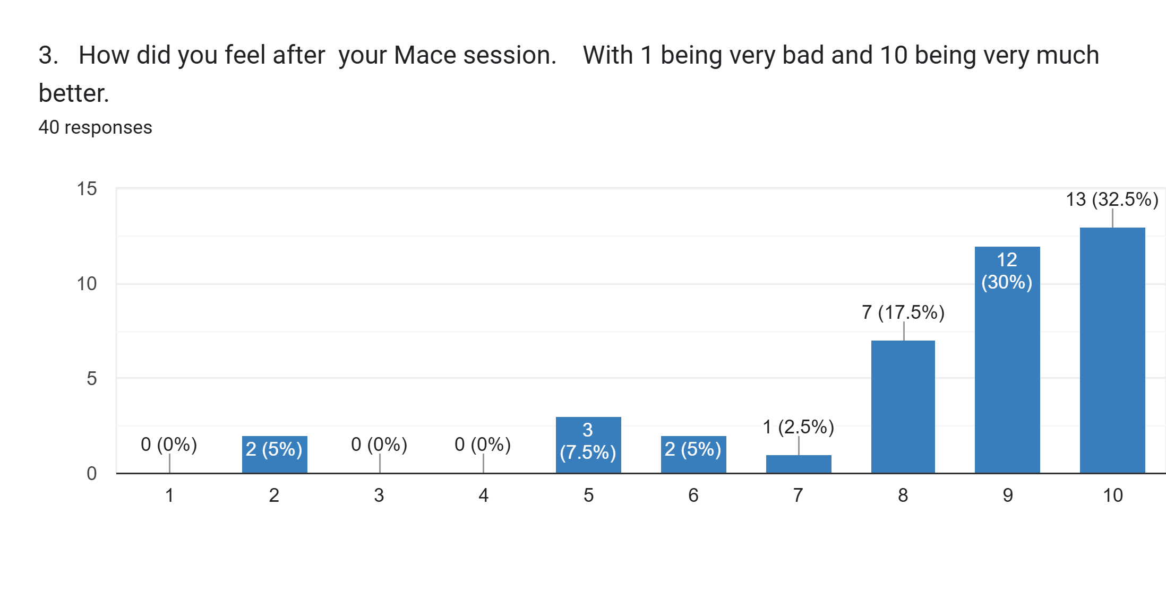
Mace Energy Impact Survey 2024-Present

Slide 4
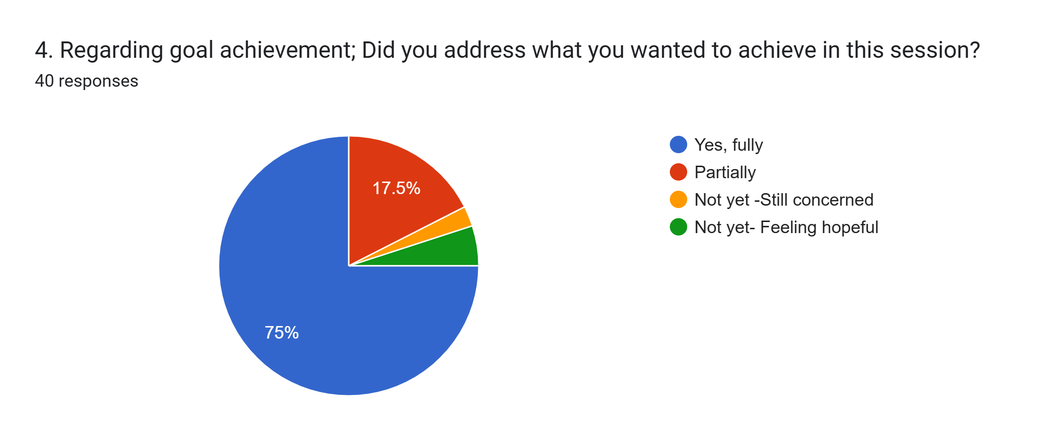
Mace Energy Impact Survey 2024-Present

Slide 5
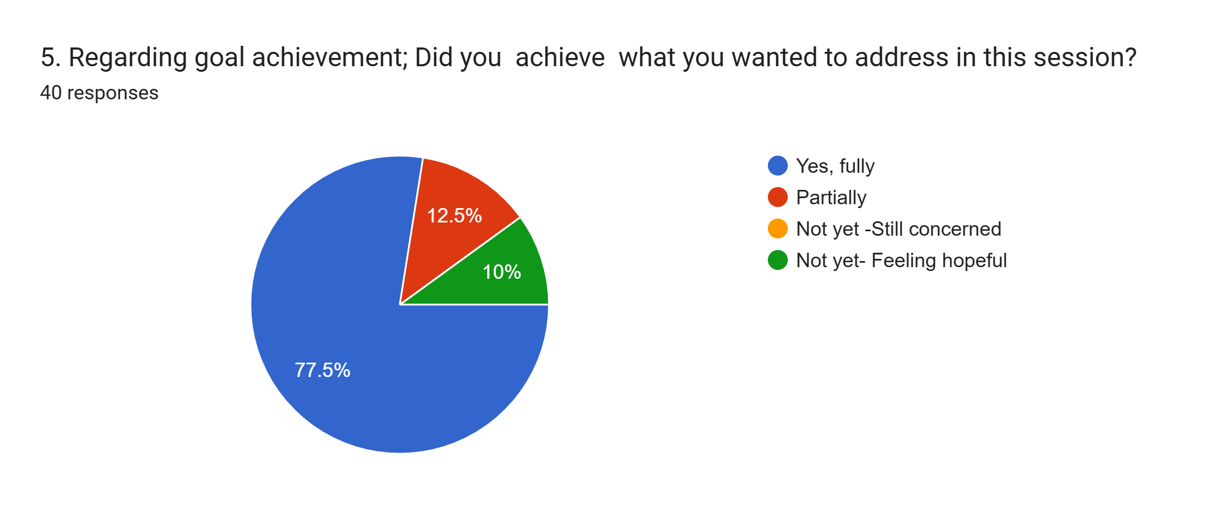
Mace Energy Impact Survey 2024-Present

Slide 6
The Mace Energy Method
Clinical Summary of Statistical Results
Before/After Emotional State Analysis

Slide 7
Mace Energy Impact Survey 2024-Present
Summary
Key Findings
Before/after Mace session scores show an extremely significant improvement.
t = 17.84, p ≈ 4.6 × 10⁻²⁰ (probability this occurred by chance is essentially zero).
Effect size (Cohen’s d = 2.86) — considered enormous in psychological research

Slide 8
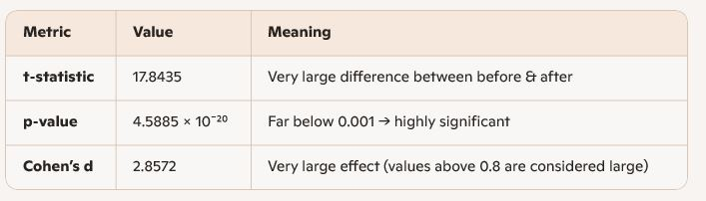
Mace Energy Impact Survey 2024-Present
Statistical Results Table

Slide 9
Mace Energy Impact Survey 2024-Present
Interpretation in Plain Language
What the Results Indicate
- Participants showed substantial improvement in emotional state after a Mace session.
- The magnitude of change is unusually strong compared to typical therapeutic interventions.
- These results provide compelling evidence of the method’s impact.

Slide 10
Mace Energy Impact Survey 2024-Present
Why this is significant
Context for Effect Size
Most therapeutic interventions show d = 0.3–0.8 (small to medium).
d > 1.0 is rare.
d ≈ 3.0 is exceptional.
Survey data shows a near tripling of emotional well‑being scores.
Paired before/after data shows a statistically significant improvement:
(p < 0.0000000000000000001) with a very large effect size (d = 2.86)

Slide 11
Mace Energy Impact Survey 2024-Present
Testimonials
“I used to feel as though I was stuck in the past, as if I had never truly grown up—still like a child who wasn’t seen or heard. I struggled to speak with confidence, especially with tall men who spoke in a way that reminded me of my father and later of my partners”
“I felt I had no control over anger and frustration. Especially when trying to improve upon my marriage. I would take a couple steps forward then two steps back. It was continually on edge as though the next outburst would seal my fate. Since my time with Dr. Jerry, my progress has steadily improved that I notice greater peace and less need to validate myself at the expense of others.”
“I feel less triggered by old memories and mistakes, and lighter in general. Practitioner was passionate, thorough and caring during my session. I would recommend this method to others.”
“This was one of the most incredible experiences I’ve had and effective at releasing negative emotions and energies I’ve had. A lot of the negative energy I had to try to put myself first or to be right is just gone”

Slide 12
Mace Energy Impact Survey 2024-Present
Testimonials
It was a life changing experience. It feels like a million pounds of weight has been lifted off my back and that my energy has been restored to me.
Recognition of patterns that were controlling Me and the ability to differentiate between my patrner's baggage and mine. I saw past the "veil" as it were, and am "seeing me" on a more objective level.

